Slide 1






BATTERY LEVEL INDICATOR

Slide 2



1
Abhik Bhattacharjee (23UEI010)
GROUP MEMBERS
2
Subhajit Bhattacharjee (23UEI059)
3
Raunak Bhattacharjee (23UEI006)
4
Indrani Chakraborty (23UEI088)
5
Arkit Das (23UEI016)
6
Mrinmoy Biswas (23UEI066)
7
Pranjal Pal (23UEI215)

Slide 3




Objective :
AMMETER
The designing and working of the project is based on some basic network theory principles. This Battery Level Indicator will helps to show the remaining battery charge through a series of LEDs. This project will help us to understand practical applications of voltage dividers, resistor networks, and other circuits.
BULB

Slide 4









Apparatus
and
Quantity
LM 3914 IC
(1PC)
Resistors(4PC)
LEDS(10PC)
Breadboard(1PC)
Potentiometer(1PC)
Wire(as req..)
Switch(1PC)

Slide 5
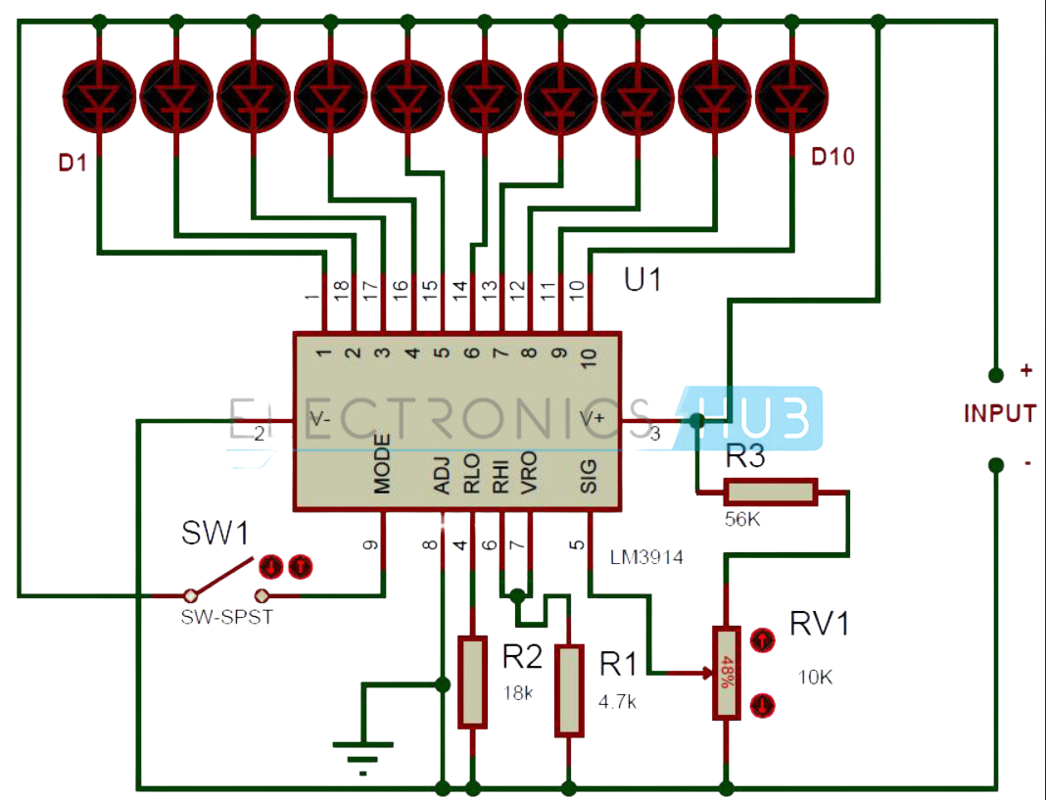
Circuit Diagram
10k
4k
3k
4k

Slide 6





Working Process
1. Connect LEDs: Connect the cathodes of 10 LEDs to pins 1-10 of the LM3914. Connect the anodes of LEDs to the positive rail of your power supply through current limiting resistors.
2. Power Supply: Connect V+ (pin 3) to the positive supply voltage (e.g., 12V).
Connect GND (pin 2) to the ground.
3. Set Reference Voltage: Connect a resistor (R1) between V+ (pin 3) and REF OUT (pin 7).
Connect another resistor (R2) between REF OUT (pin 7) and GND. Optionally, use a potentiometer to adjust the reference voltage.
4. Battery Connection: Connect the battery positive terminal to the input signal (pin)
Connect the battery negative terminal to GND.
5. Mode Selection: For bar mode, leave MODE (pin 9) open or connect to V+.
For dot mode, connect MODE (pin 9) to GND.
6. Final Connections: Connect REF ADJ (pin 8) to REF OUT (pin 7) through a resistor to set the LED current.

Slide 7
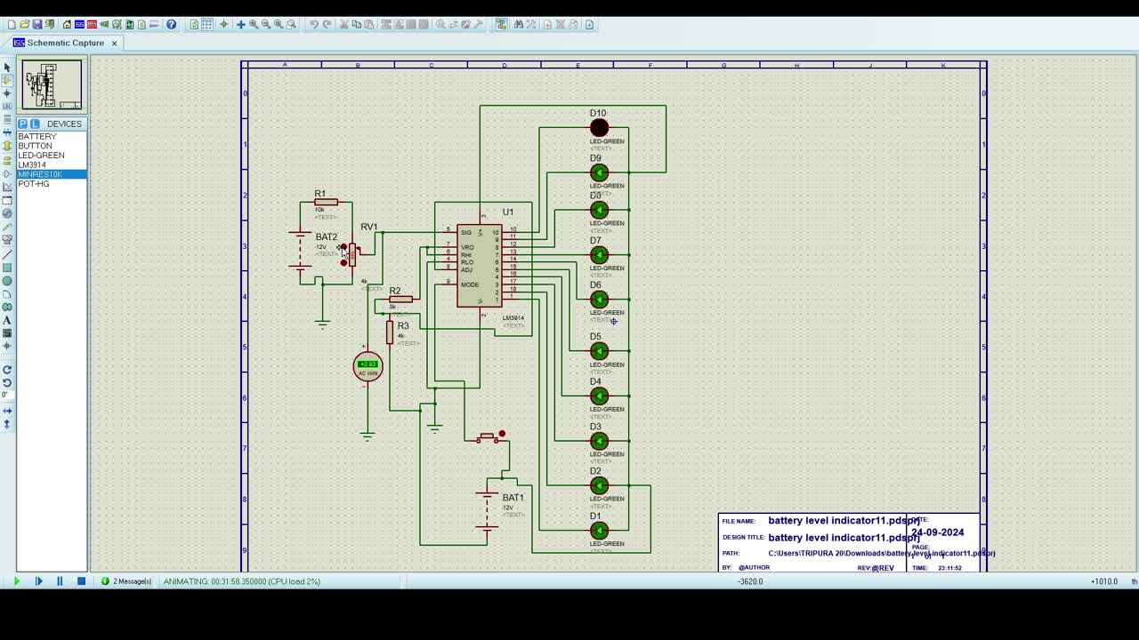
USing Simulating Software
As the voltage is decreasing
the led blinks off

Slide 8
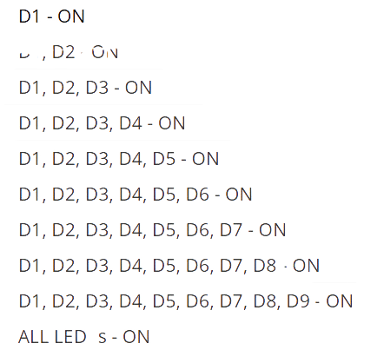
The status of LED’s with input voltage level.
Battery Level
Status of leds
0.31V
0.62V
0.89V
D1, D2 -ON
1.20V
1.47V
1.78V
2.06V
2.37V
2.64V
2.94V

